Slide 1


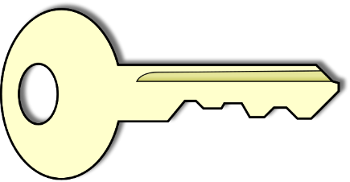

Slide 2




Splitting
Algorithm

Slide 3
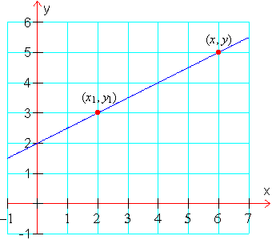

I need access to the Doc!
(x,y) → Memory Loc A
(x1 , y1) → Memory Loc B

Slide 4
Loc A and B shared to User
Timer Begins Simultaneously
0
1
2
3
4
5
6
7
8
9
10
End of Timer →
Loc A and Loc B Erased

